Slide 1
Spotify Trend Analysis
BY
ABISHEK.S

Slide 2
Table of Contents
Business Task
Data Sources
Data Cleaning and Manipulation
Visualizations and Key Findings
Recommendations

Slide 3
Business Task
The primary business task is to analyze Spotify Trend data to gain insights into performance and identify opportunities for growth by creating interactive reports and dashboards using Power BI.

Slide 4
Data Sources
List of Data Sources:
Source 1: Spotify usage logs (Spotify.csv)
Data Acquisition:
Data was collected through Google Drive, including information on songs, artists, and streaming sessions.

Slide 5
Data Cleaning and Manipulation
Cleaning Processes:
Handling Date Formats:
Inconsistent Date Formats: Dates initially in mixed formats, with some in numerical form and others in text form, were identified.
Standardization: All dates were standardized and converted into a consistent, appropriate date format.
Symbol Removal: Removed the symbols from the columns to ensure the data is clean and properly formatted for analysis.
Data Manipulation:
Creating New Variables:
Days Column: A new column for days was created to represent the day of the week.

Slide 6
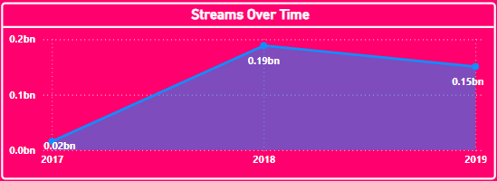
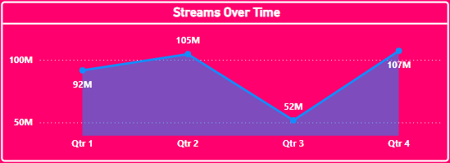
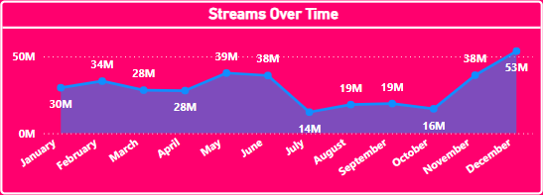
Visualizations and Key Findings
Visualization 1: Streams Over Time

Slide 7
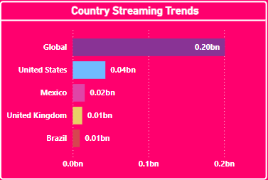
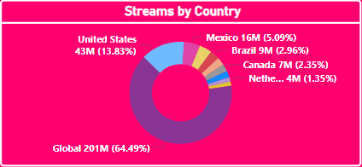
Visualizations and Key Findings
Visualization 2: Country Streaming Trends

Slide 8
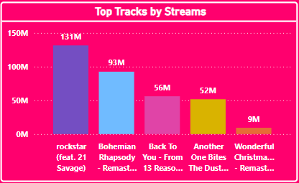
Visualizations and Key Findings
Visualization 3: Top 5 Tracks by Streams

Slide 9
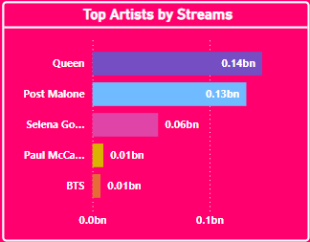
Visualizations and Key Findings
Visualization 4: Top 5 Artists by StreamsAnalysis of start and end stations based on rider pick-up and drop-off locations reveals patterns in ride destinations.

Slide 10
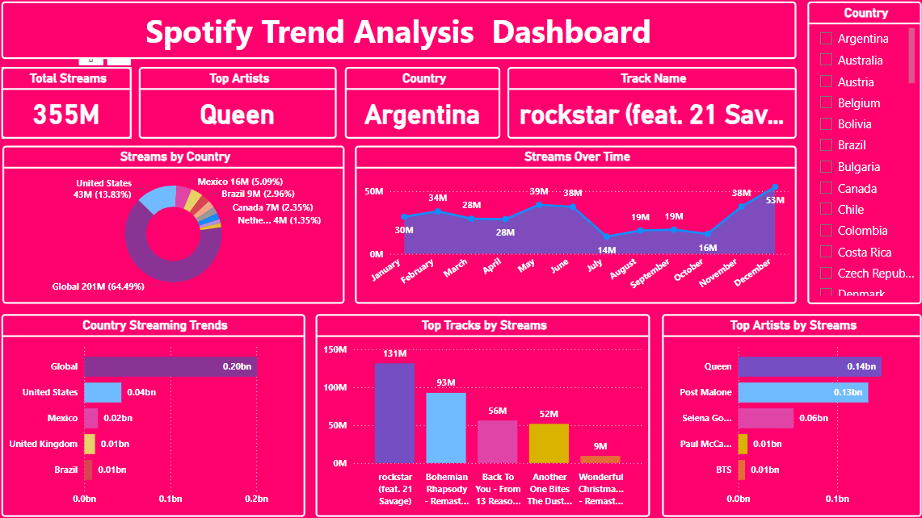
Visualizations and Key Findings
Visualization 5: Spotify Trend Analysis Dashboard

Slide 11
Recommendations
Recommendation 1: Focus on Growing Emerging Markets
Based on Analysis: Streams from countries like Mexico, Brazil, and Canada contribute a smaller percentage compared to the United States and global streams.
Expected Outcome: By tailoring localized marketing strategies and exclusive promotions in these countries, streaming numbers can be significantly increased, boosting overall growth.

Slide 12
Recommendations
Recommendation 2: Increase Engagement During Off-Peak Months
Based on Analysis: The streams show a significant drop from July to October compared to the peaks in May and December.
Expected Outcome: By launching special campaigns, exclusive releases, and artist collaborations during these off-peak months, the platform can maintain more consistent stream rates throughout the year.

Slide 13
Recommendations
Recommendation 3: Promote Popular Tracks Across Various Regions
Based on Analysis: Tracks like rockstar and Bohemian Rhapsody have significantly higher streams compared to other tracks.
Expected Outcome: Promote these popular tracks across multiple regions using playlists, ads, and recommendations to further capitalize on their success and increase total streams.

Slide 14
Recommendations
Recommendation 4: Leverage Top Artists for Global Promotions
Based on Analysis: Artists like Queen and Post Malone dominate streams in the top artists' section, indicating their global appeal.
Expected Outcome: Organizing global campaigns around these top artists can attract more listeners from regions with lower streams, enhancing their global reach and platform engagement.

